Slide 1
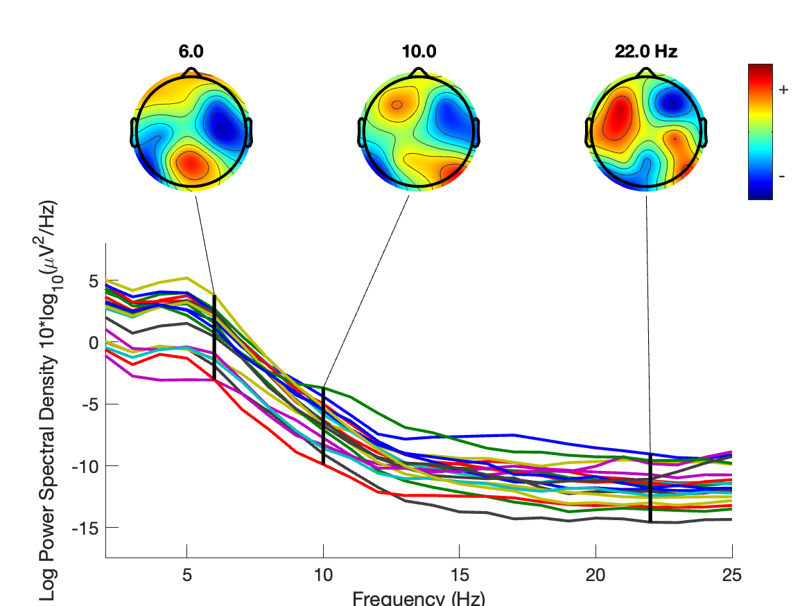
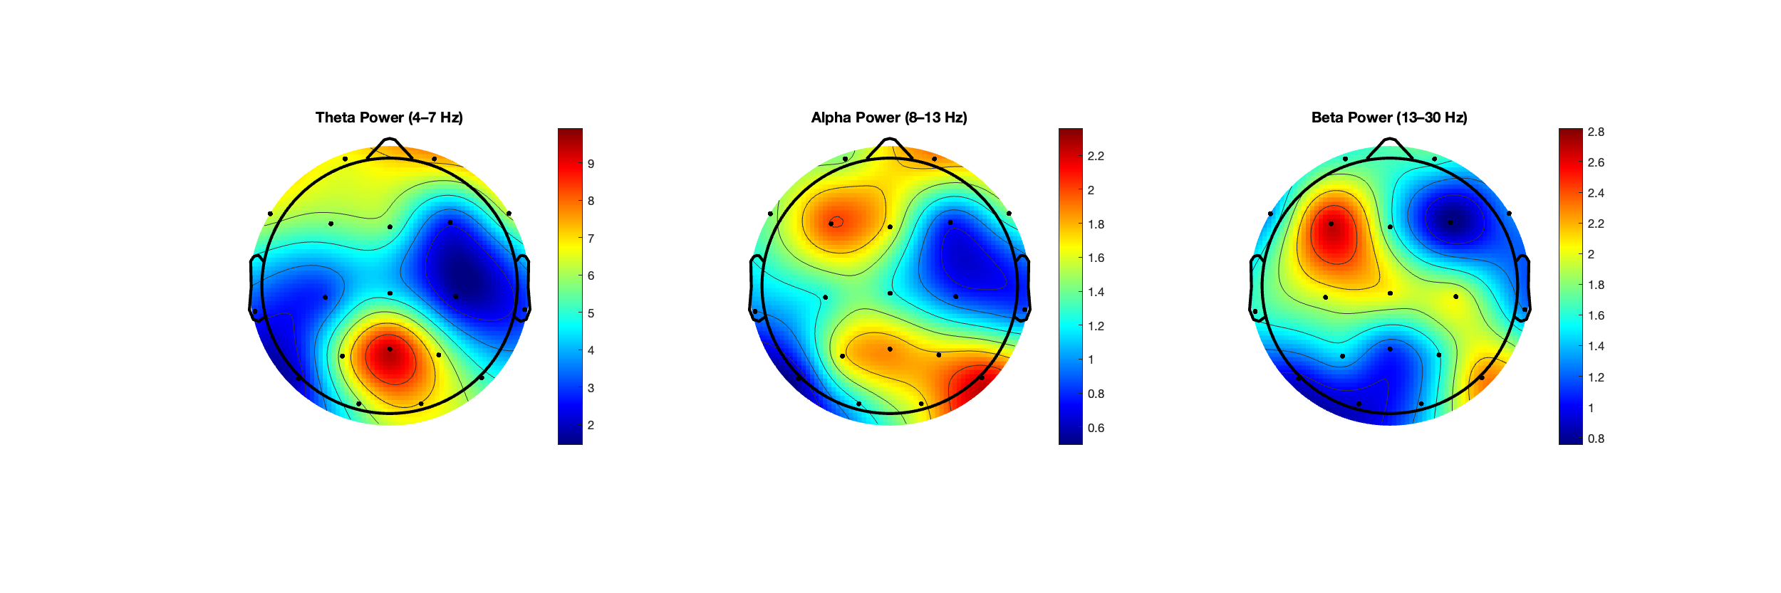
EEG Analysis: From ICA Cleaning to Bandpower Topomaps OpenNeuro Subject 001 (Resting-State, 19 Channels)
Tools Used: MATLAB, EEGLAB
Dataset: OpenNeuro ds004504 (Clinical, Eyes Closed)
Channels: 19 electrodes, standard 10–20 layout
Pipeline Summary:
• Loaded .set file in EEGLAB
• ICA-based artifact rejection (eye blinks, muscle)
• PSD computed (2–25 Hz)
• Bandpower extracted (Theta, Alpha, Beta)
• 3 scalp topographic maps visualized
Independent EEG preprocessing and analysis project using EEGLAB and MATLAB. Demonstrates artifact rejection, frequency-domain feature extraction, and spatial topographic visualization from clinical data.
Notes:
Points:
This analysis showcases a full EEG preprocessing pipeline using EEGLAB on an open clinical dataset (resting-state, eyes closed, 19 channels).
After ICA-based artifact rejection, I computed power spectral density (PSD) and extracted frequency bandpowers to examine regional brain activity.
The theta power is most prominent in posterior regions — a typical feature of eyes-closed resting-state EEG.
The alpha band peaks in occipital and parietal sites, reflecting relaxed wakefulness and typical visual disengagement.
Beta power shows more diffuse frontal-central activity, possibly representing background muscle tone or vigilance-related features.
These scalp distributions are consistent with canonical resting-state profiles and demonstrate my ability to preprocess, denoise, and extract meaningful EEG features.
This pipeline is adaptable for clinical datasets, cognitive paradigms, or brain-computer interface applications.

